Slide 1
quadkey | CDUID | tests | conn_ type | SACTYPE | PCTYPE | avg_d_kbps | ...
110101 | 1 | 2 | fixed | 7 | NaN | 13 | ...
110042 | 1 | 100 | fixed | 7 | NaN | 100 | ...
120392 | 1 | 23 | mobile | 8 | 6 | 56 | ...
122833 | 2 | 51 | fixed | 5 | 1 | 72 | ...
120293 | 2 | 2 | mobile | 6 | 2 | 14 | ...
120504 | 2 | 18 | mobile | 6 | 2 | 22 | ...
... | ... | ... | ... | ... | ... | ...
Group by: CDUID, conn_type, SACTYPE, is_rural.
weight = ‘tests’.
2,751,464 million rows → 2,771.
Imputation: the latest speed.
CDUID | conn_ type | SACTYPE | is_rural (PCTYPE=NaN) | tests | avg_d_mbps | ...
1 | fixed | 7 | 1 | 2 | 13 | ...
1 | fixed | 7 | 1 | 100 | 100 | ...
2 | mobile | 8 | 0 | 23 | 56 | ...
2 | fixed | 5 | 0 | 51 | 72 | ...
2 | mobile | 6 | 0 | 2 | 20 | ...
... | ... | ... | ... | ... | ...

Slide 2
imputation
quadkey | time | ... | avg_d _mbps | ...
110101 | 2019-1Q | ... | 13 | ...
110101 | 2019-3Q | ... | 30 | ...
110101 | 2019-4Q | ... | 56 | ...
110101 | 2020-4Q | ... | 72 | ...
110101 | 2021-1Q | ... | 120 | ...
110101 | 2021-3Q | ... | 130 | ...
... | ... |  | ...
quadkey | time | ... | avg_d _mbps | ...
110101 | 2019-1Q | ... | 13 | ...
110101 | 2019-2Q | ... | 13 | ...
110101 | 2019-3Q | ... | 30 | ...
110101 | 2019-4Q | ... | 56 | ...
110101 | 2020-1Q | ... | 56 | ...
110101 | 2020-2Q | ... | 56 | ...
... | ... |  | ...
Impute missing
time points

Slide 3
imputation (missing 2~10)
e.g., impute data for:
CDUID=6204(Baffin), PRUID=62(Nunavut), is_rural=1, conn_type=mobile, SACTYPE=6 in 2020-2Q
Find regions with the same CDUID, PR, conn_type, is_rural, time (only vary in SACTYPE)
Find regions with the same CDUID, PR, SACTYPE, is_rural, time (only vary in conn_type)
Find regions with the same PR, SACTYPE, conn_type, is_rural, time (only vary in CDUID)
CDUID | PRUID | SACTYPE | conn_type | is_rural | time | ... | avg_d _mbps
6204 | 62 | 3 | mobile | 1 | 2020-2Q | ... | 99
6204 | 62 | 6 | mobile | 1 | 2020-2Q | ... | 82
6204 | 62 | 7 | mobile | 1 | 2020-2Q | ... | 44
6204 | 62 | 8 | mobile | 1 | 2020-2Q | ... | 56
CDUID | PRUID | SACTYPE | conn_type | is_rural | time | ... | avg_d _mbps
6204 | 62 | 6 | fixed | 1 | 2020-2Q | ... | 77
CDUID | PRUID | SACTYPE | conn_type | is_rural | time | ... | avg_d _mbps
6201 | 62 | 6 | mobile | 1 | 2020-2Q | ... | 31
6202 | 62 | 6 | mobile | 1 | 2020-2Q | ... | 53
6205 | 62 | 6 | mobile | 1 | 2020-2Q | ... | 30
6106 | 62 | 6 | mobile | 1 | 2020-2Q | ... | 32

Slide 4
Target:
Source 1: The other conn_type
CDUID | SACTYPE | conn_type | is_rural | time | ... | avg_d _mbps
6204 | 6 | mobile | 1 | 2020-2Q | ... | 61.25
CDUID | SACTYPE | conn_type | is_rural | time | ... | avg_d _mbps
6204 | 6 | fixed | 1 | 2020-2Q | ... | 77
Source 1: Regions that vary only in SACTYPE)
Source 3: Regions that vary only in CDUID
CDUID | SACTYPE | conn_type | is_rural | time | ... | avg_d _mbps
6204 | 3 | mobile | 1 | 2020-2Q | ... | 99
6204 | 6 | mobile | 1 | 2020-2Q | ... | 82
6204 | 7 | mobile | 1 | 2020-2Q | ... | 44
6204 | 8 | mobile | 1 | 2020-2Q | ... | 56
CDUID | SACTYPE | conn_type | is_rural | time | ... | avg_d _mbps
6201 | 6 | mobile | 1 | 2020-2Q | ... | 31
6202 | 6 | mobile | 1 | 2020-2Q | ... | 53
6205 | 6 | mobile | 1 | 2020-2Q | ... | 30
6106 | 6 | mobile | 1 | 2020-2Q | ... | 32

Slide 5
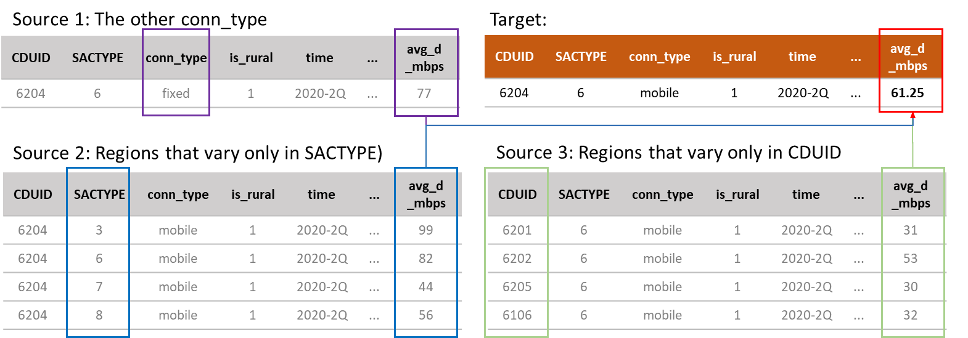
Source 1: The other conn_type
Target:
CDUID | SACTYPE | conn_type | is_rural | time | ... | avg_d _mbps
6204 | 6 | fixed | 1 | 2020-2Q | ... | 77
CDUID | SACTYPE | conn_type | is_rural | time | ... | avg_d _mbps
6204 | 6 | mobile | 1 | 2020-2Q | ... | 61.25
Source 2: Regions that vary only in SACTYPE)
Source 3: Regions that vary only in CDUID
CDUID | SACTYPE | conn_type | is_rural | time | ... | avg_d _mbps
6204 | 3 | mobile | 1 | 2020-2Q | ... | 99
6204 | 6 | mobile | 1 | 2020-2Q | ... | 82
6204 | 7 | mobile | 1 | 2020-2Q | ... | 44
6204 | 8 | mobile | 1 | 2020-2Q | ... | 56
CDUID | SACTYPE | conn_type | is_rural | time | ... | avg_d _mbps
6201 | 6 | mobile | 1 | 2020-2Q | ... | 31
6202 | 6 | mobile | 1 | 2020-2Q | ... | 53
6205 | 6 | mobile | 1 | 2020-2Q | ... | 30
6106 | 6 | mobile | 1 | 2020-2Q | ... | 32

Slide 6
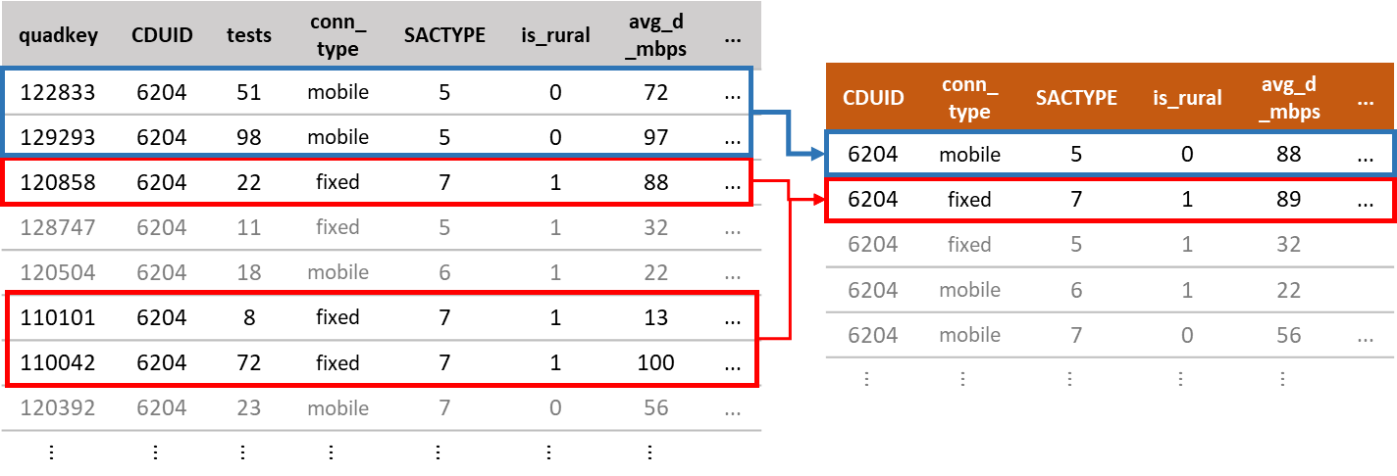
Grouping
quadkey | CDUID | tests | conn_ type | SACTYPE | is_rural | avg_d _mbps | ...
122833 | 6204 | 51 | mobile | 5 | 0 | 72 | ...
129293 | 6204 | 98 | mobile | 5 | 0 | 97 | ...
120858 | 6204 | 22 | fixed | 7 | 1 | 88 | ...
128747 | 6204 | 11 | fixed | 5 | 1 | 32 | ...
120504 | 6204 | 18 | mobile | 6 | 1 | 22 | ...
110101 | 6204 | 8 | fixed | 7 | 1 | 13 | ...
110042 | 6204 | 72 | fixed | 7 | 1 | 100 | ...
120392 | 6204 | 23 | mobile | 7 | 0 | 56 | ...
... | ... | ... | ... | ... | ... | ...
CDUID | conn_ type | SACTYPE | is_rural | avg_d _mbps | ...
6204 | mobile | 5 | 0 | 88 | ...
6204 | fixed | 7 | 1 | 89 | ...
6204 | fixed | 5 | 1 | 32
6204 | mobile | 6 | 1 | 22
6204 | mobile | 7 | 0 | 56 | ...
... | ... | ... | ... | ...
Notes:
For each time point, we aggregated the speeds data by the census division, connection type, statistical class type, and population centre type.

Slide 7
Model performances
Model | Coefficients | RMSE (avg_d_mbps) | RMSE (avg_u_mbps)
Baseline (most recent speeds)
ARIMA
Mixed-effects
Ensemble

Slide 8
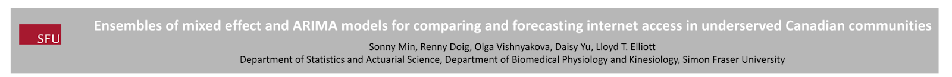

Slide 9
